Slide 1
Estimating the Influence of Racial Attitudes on Attitudes about the Projected Minority Status of Whites in the United States
L.J Zigerell Illinois State University Presentation at MPSA 2025
1

Slide 2
Introduction
The percentage of the U.S. population that is White has decreased from 80 percent in 1980 to 58 percent in 2020, with non-Hispanic Whites projected to become a minority of the U.S. population in 2045.
2

Slide 3
Literature Review
Experimental research has indicated that making this demographic change salient among Whites…
increased fear of racial minorities (Outten et al. 2012)
increased political conservatism (Craig and Richeson 2014b)
reduced feeling thermometer ratings about Blacks, Hispanics, and Asians (Craig and Richeson 2014a)
3

Slide 4
Literature Review
Correlational research has investigated correlates of the belief that an unnamed group or a specific group is responsible for this decline in the percentage White…
in the United States, with data from a sample of White U.S. residents (Klofstad et al. 2024)
in European countries, with data from samples from various European countries (Herold 2025)
4

Slide 5
Goals
The present study attempts to...
assess the cause of attitudes about whether Whites becoming a minority in the United States is a positive change or a negative change.
illustrate a few ways to estimate the influence of attitudes about a group, that might be better than a typical method in the literature.
5

Slide 6
Theory / Hypotheses
Realistic group conflict theory
H₁: Nonwhites will be more likely than Whites to report that Whites becoming a minority in the United States is a positive change.
Racial attitudes
H₂: Persons who have negative attitudes about Whites relative to nonWhites will be more likely than persons who have neutral attitudes and/or positive attitudes about Whites to report that Whites becoming a minority in the United States is a positive change.
6

Slide 7
Research Design
Data source: American National Election Studies (ANES) 2022 Pilot Study
Data collection dates: Mid-November 2022
Data collection method: YouGov online opt-in panel
Sample size: 1,500
Population: U.S. citizens aged 18 and above
7

Slide 8
Research Design
Outcome item: "The demographic makeup of America is changing, with the U.S. Census Bureau estimating white people will become a minority. How positive or negative do you find these changes?"
Five response options offered:
very positive
somewhat positive
neither positive nor negative
somewhat negative
very negative
8

Slide 9
Research Design
Key predictor: Based on 0-to-100 feeling thermometer ratings about "whites" or "White people" (randomly assigned, but no meaningful difference in means), "blacks" or "Black people" (randomly assigned, but no meaningful difference in means), "Hispanics", and "Asians"...
Absolute ratings, such as within the 0-to-49 category
Relative ratings, in various dichotomous categories, such as rating Whites cold and colder than each of Blacks, Hispanics, and Asians
9

Slide 10
Research Design
Controls: For some analyses, controls are included for participant demographics of...
gender
race/ethnicity
age group
education
family income
immigration background (e.g., immigrant citizen, first generation, second generation)
10

Slide 11
Research Design
Error bars in the figures are 83.4% confidence intervals (Payton et al. 2003).
Data analysis was conducted in Stata 15.
Data visualizations were produced in R using the tidyverse package (Wickham et al. 2019) and the patchwork package (Pederson 2022).
11

Slide 12
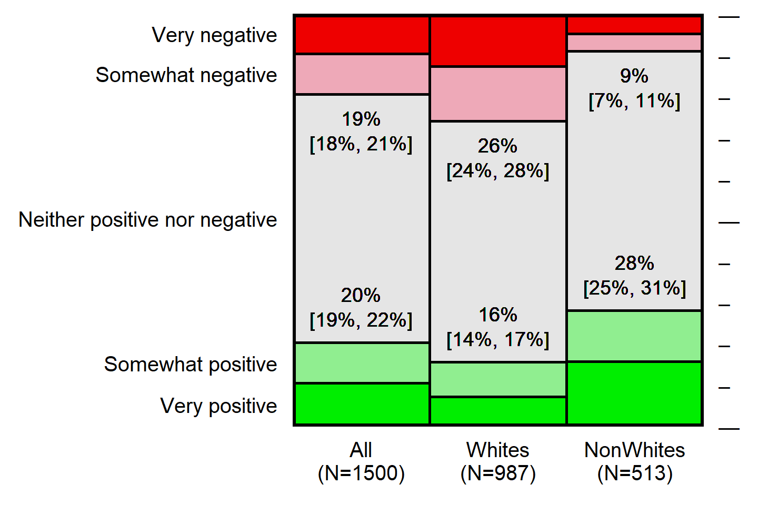
Outcome Variable Distribution
Note: Figure reports the distribution of responses to the item: "The demographic makeup of America is changing, with the U.S. Census Bureau estimating white people will become a minority. How positive or negative do you find these changes?". Estimates are weighted to reflect the population of adult U.S. citizens.
12

Slide 13
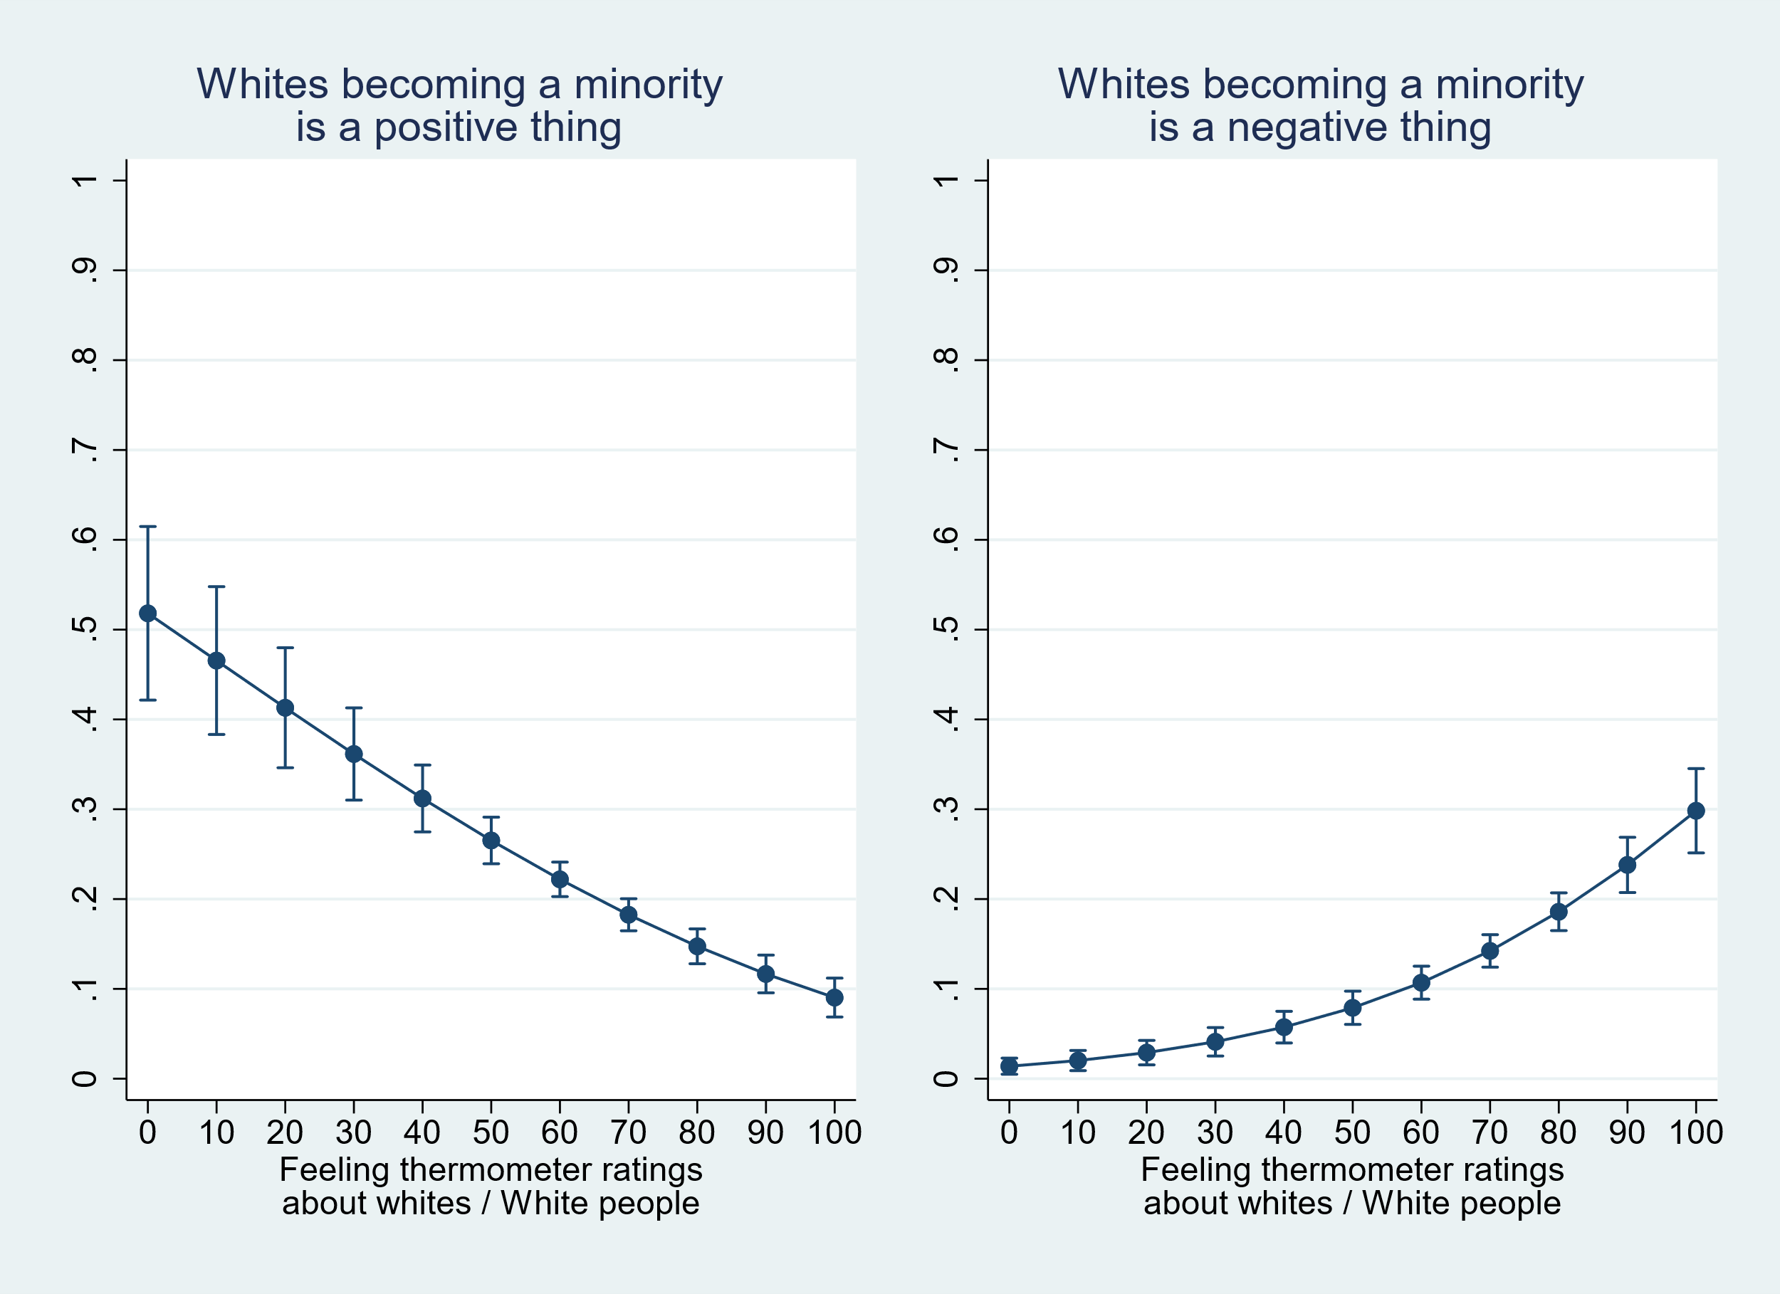
Common Reporting of Results
Note: Figure reports the predicted probability that an adult U.S. citizen indicated that Whites becoming a minority in America was somewhat positive or very positive (left panel) or somewhat negative or very negative (right panel), from a multinomial regression that had predictors for participant feeling thermometer ratings about Whites, Blacks, Hispanics, and Asians as continuous 0-to-100 measures and that had categorical controls for participant gender, race, immigrant status, age group, education, and income. Error bars are 83.4% confidence intervals.
13

Slide 14
Common Reporting of Results
Potential shortcomings of this method:
Assumes a continuous association between X and Y net of controls
Doesn't credibly calculate differences between predicted Ys at different Xs
Can produce precise estimates for Xs that have no observations (the predicted Y for observations at X=100 depends on observed Ys for observations at X=60)
14

Slide 15
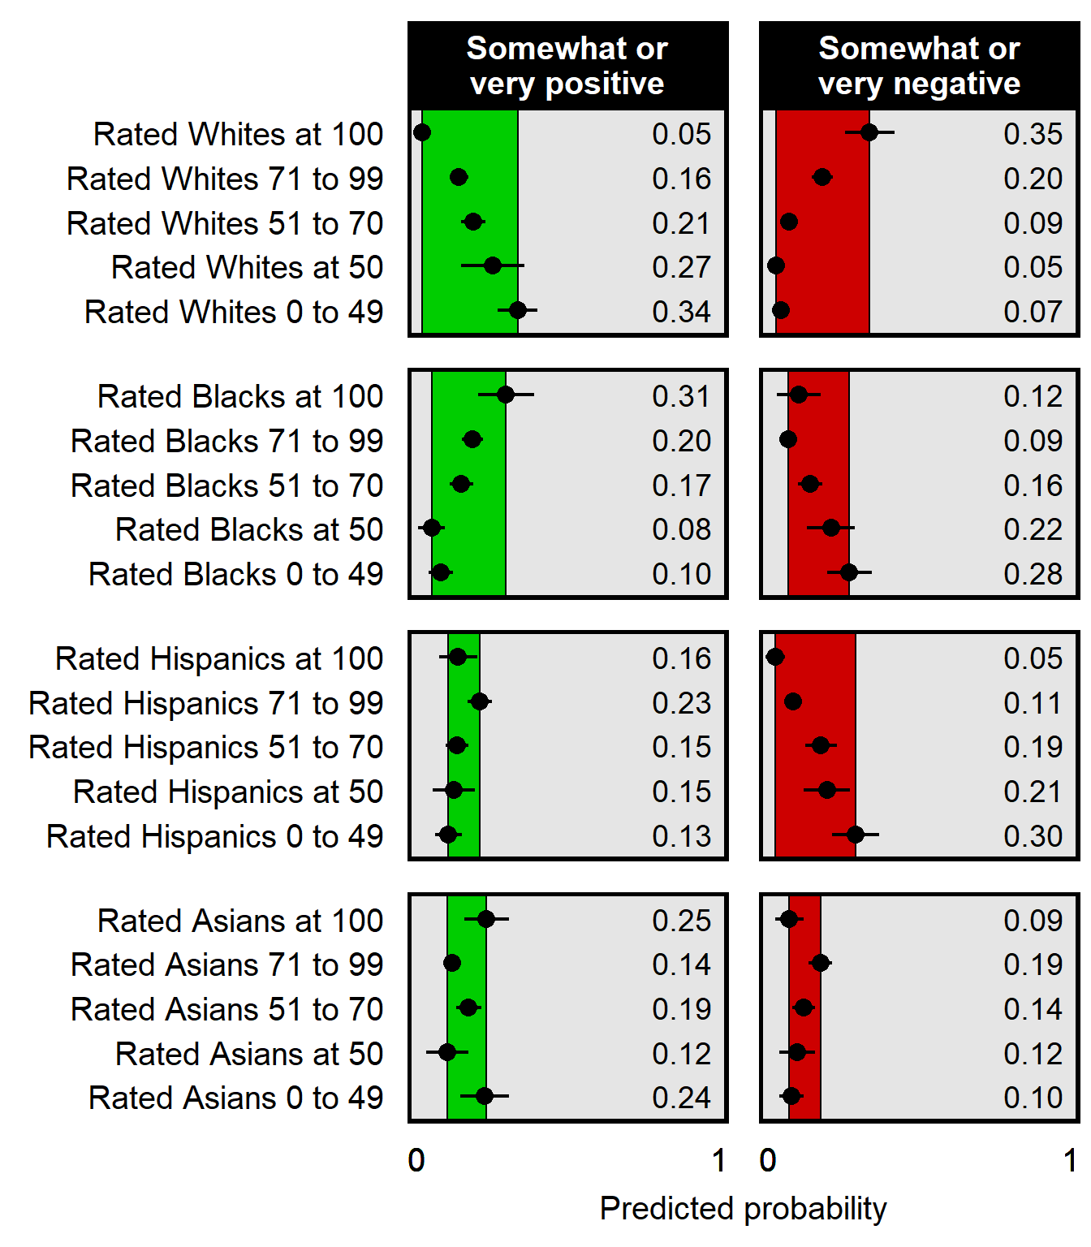
Predictors: Independent Categorical Ratings
Note: Figure reports the predicted probability that an adult U.S. citizen indicated that Whites becoming a minority in America was somewhat positive or very positive (left panels) or somewhat negative or very negative (right panels), from a multinomial regression that had categorical predictors for participant feeling thermometer ratings about Whites, Blacks, Hispanics, and Asians and that had categorical controls for participant gender, race, immigrant status, age group, education, and income. Error bars are 83.4% confidence intervals.
15

Slide 16
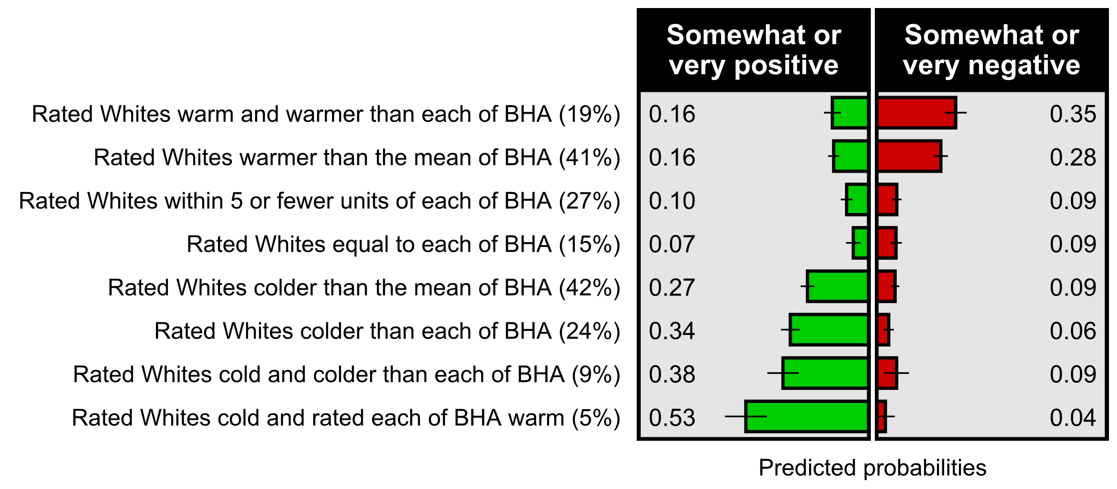
Predictors: Combined Categorical Ratings
Note: Figure reports estimated predicted probabilities that an adult U.S. citizen indicated that Whites becoming a minority in America was somewhat positive or very positive (left panel) or somewhat negative or very negative (right panel), for particular combinations of ratings about Whites and Blacks, Hispanics, and Asians (BHA) controlling for demographics. Error bars are 83.4% confidence intervals. The category of rated Whites warmly and rated each of BHA coldly had only 30 participants, with 83.4% confidence intervals of [10%, 45%] for somewhat or very positive and [22%, 57%] for somewhat or very negative.
16

Slide 17
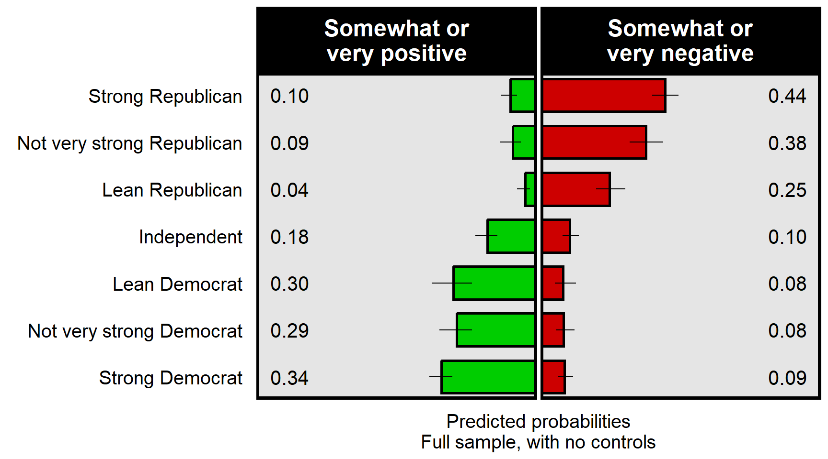
Predictor: Partisanship
Note: Figure reports estimated predicted probabilities that an adult U.S. citizen indicated that Whites becoming a minority in America was somewhat positive or very positive (left panel) or somewhat negative or very negative (right panel), by levels of partisanship. Error bars are 83.4% confidence intervals.
17

Slide 18
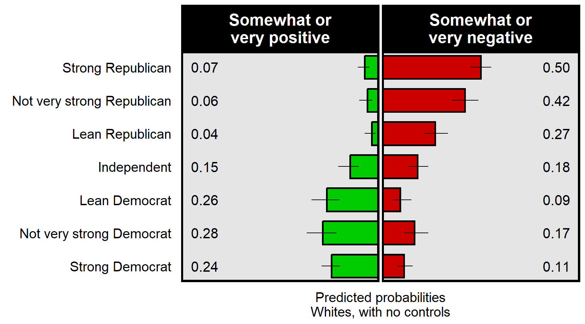
Predictors: Partisanship among Whites
Note: Figure reports estimated predicted probabilities that a White adult U.S. citizen indicated that Whites becoming a minority in America was somewhat positive or very positive (left panel) or somewhat negative or very negative (right panel), by levels of partisanship. Error bars are 83.4% confidence intervals. Sample limited to White respondents.
18

Slide 19
Discussion
Substantively...
Compared to U.S. adults who have neutral or positive attitudes about White people, U.S. adults who have negative views about White people are more likely to perceive Whites becoming a minority in America to be a positive change.
19

Slide 20
Discussion
Methodologically, categorical codings had advantages:
permitted identification of non-linearities
permitted more credible estimates of the effect of positive and negative attitudes about Whites, relative to neutrality
produced estimates for a category that were not dependent on observations in other categories
20

Slide 21
Thank you!
References
American National Election Studies. 2022. ANES 2022 Pilot Study [dataset and documentation]. December 14, 2022 version. www.electionstudies.org
Azari, Shabnam Shenasi, Virginia Jenkins, Joyce Hahn, and Lauren Medina. 2024. “The foreign-born population in the United States: 2022”. United States Census Bureau.
Camus, Renaud. 2011. Le grand remplacement. Reinharc.
Camus, Renaud. 2018. You will not replace us! Chez l’auteur.
Craig, Maureen A., and Jennifer A. Richeson. 2014a. “More diverse yet less tolerant? How the increasingly diverse racial landscape affects White Americans’ racial attitudes.” Personality and Social Psychology Bulletin 40(6): 750-761.
Craig, Maureen A., and Jennifer A. Richeson. 2014b. “On the precipice of a ‘majority-minority’ America: Perceived Status Threat from the racial demographic shift affects White Americans’ political ideology”. Psychological Science 25(6): 1189-1197.
21

Slide 22
References
Engelhardt, Andrew M., Nicole Huffman, and Veronica Oelerich. 2025. “Validating Whites’ reactions to the ‘Racial Shift’”. Journal of Experimental Political Science. Early view.
Goldberg, Zach. 2019. “America’s White saviors”. Tablet Magazine. June 5.
Hainmueller, Jens, Jonathan Mummolo, and Yiqing Xu. 2019. “How much should we trust estimates from multiplicative interaction models? Simple tools to improve empirical practice”. Political Analysis 27(2): 163-192.
Herold, Maik. 2025. “Who believes in the ‘Great Replacement’? Political attitudes and democratic alienation among supporters of immigration-related conspiracy theories in Europe”. Social Science Quarterly 106:e13481.
Jensen, Eric, Nicholas Jones, Megan Rabe, Beverly Pratt, Lauren Medina, Kimberly Orozco, and Lindsay Spell. 2021. “The chance that two people chosen at random are of different race or ethnicity groups has increased since 2010”. United States Census Bureau. August 12. https://www.census.gov/library/stories/2021/08/2020-united-states-population-more-racially-ethnically-diverse-than-2010.html
Klofstad, Casey, Olyvia Christley, Amanda Diekman, Sandra Kübler, Adam Enders, John Funchion, Shane Littrell, Manohar Murthi, Kamal Premaratne, Michelle Seelig, Daniel Verdear, Stefan Wuchty, Hugo Drochon, and Joseph Uscinski. 2024. “Belief in White replacement”. Politics, Groups, and Identities 1-25.
Krogstad, Jens Manuel, Amina Dunn, and Jeffrey S. Passel. 2021. “Most Americans say the declining share of White people in the U.S. is neither good nor bad for society”. Pew Research Center. August 23. https://www.pewresearch.org/short-reads/2021/08/23/most-americans-say-the-declining-share-of-white-people-in-the-u-s-is-neither-good-nor-bad-for-society/
LeVine, Robert A., and Donald T. Campbell. 1972. Ethnocentrism: Theories of conflict, ethnic attitudes and group behavior. New York: John Wiley & Sons, Inc.
22

Slide 23
References
Moslimani, Mohamad, and Jeffrey S. Passel. 2024. “What the data says about immigrants in the U.S.”. Pew Research Center. September 27. https://www.pewresearch.org/short-reads/2024/09/27/key-findings-about-us-immigrants/
Obaidi, Milan, Jonas Kunst, Simon Ozer, and Sasha Y. Kimel. 2022. “The ‘Great Replacement’ conspiracy: How the perceived ousting of Whites can evoke violent extremism and Islamophobia”. Group Processes & Intergroup Relations 25(7): 1675-1695.
Payton, Mark E., Matthew H. Greenstone, and Nathaniel Schenker. 2003. “Overlapping confidence intervals or standard error intervals: What do they mean in terms of statistical significance?”. Journal of Insect Science 3(1): 34.
Pedersen, Thomas Lin. 2022. patchwork: The Composer of Plots. R package version 1.1.2, https://CRAN.R-project.org/package=patchwork R Core Team. 2024. R: A language and environment for statistical computing. R Foundation for Statistical Computing, Vienna, Austria. URL https://www.R-project.org/
Sherif, Muzafer. 1956. “Experiments in group conflict”. Scientific American 195(5): 54-59.
StataCorp. 2017. Stata Statistical Software: Release 15. College Station, TX: StataCorp LLC.
U.S. Department of Commerce Bureau of the Census. 1983. 1980 Census of the Population. Volume 1. Characteristics of the Population. Chapter B. General Population Characteristics. Part 1. United States Summary. PC80-1-B1.
Vespa, Jonathan, Lauren Medina, and David M. Armstrong. 2020. “Demographic turning points for the United States: Population projections for 2020 to 2060”. Current Population Reports. P25-1144. United States Census Bureau.
Wickham, Hadley, Mara Averick, Jennifer Bryan, Winston Chang, Lucy D’Agostino McGowan, Romain François, Garrett Grolemund, Alex Hayes, Lionel Henry, Jim Hester, Max Kuhn, Thomas Lin Pedersen, Evan Miller, Stephan Milton Bache, Kirill Müller, Jeroen Ooms, David Robinson, Dana Paige Seidel, Vitalie Spinu, Kohske Takahashi, Davis Vaughan, Claus Wilke, Kara Woo, and Hiroaki Yutani. 2019. “Welcome to the Tidyverse”. Journal of Open Source Software 4(43): 1686. https://doi.org/10.21105/joss.01686
23

Slide 24
References
Link for more results
24

